Slide 1
Opening an ABLE
Account online

Slide 2
Opening an
Account Online

Slide 3
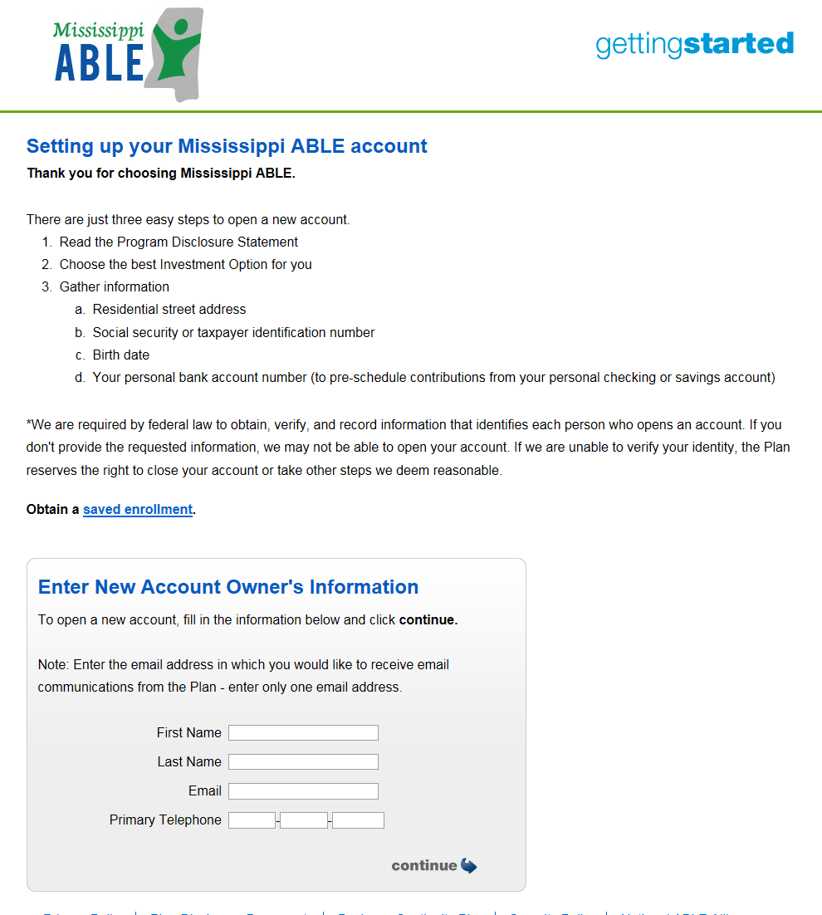

Online Enrollment
The Account Owners information would need to be entered in the grey area. Once the information has been added click the “Continue” Button
Confidential: For Ascensus Internal purposes or Client use only
3

Slide 4
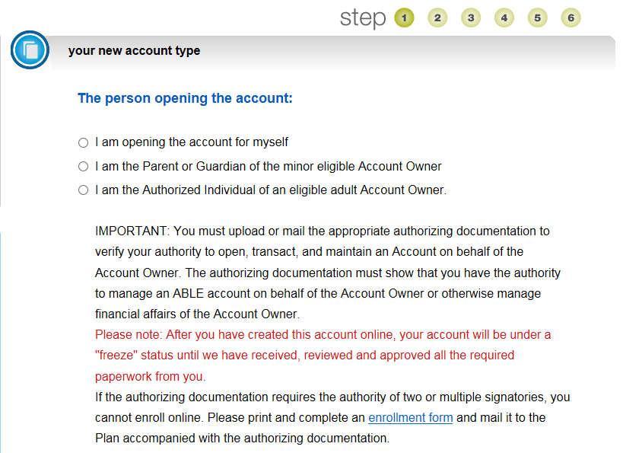
Online Enrollment
Step 1
Select the type of Account you would like to open.
Confidential: For Ascensus Internal purposes or Client use only
4

Slide 5
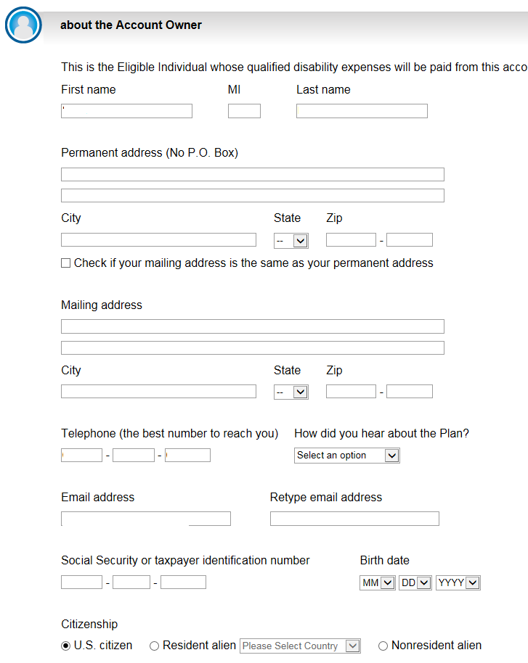
Online Enrollment
Step 1 (Cont’d)
Enter the Account Owners information:
  First Name
  Middle Initial
  Last Name
  Permanent Address
  Mailing Address
  Telephone Number
  “How did you hear about the Plan”
  Email address
  Retype email Address
  Social Security Number
  Date of Birth
  Citizenship
Confidential: For Ascensus Internal purposes or Client use only
5

Slide 6
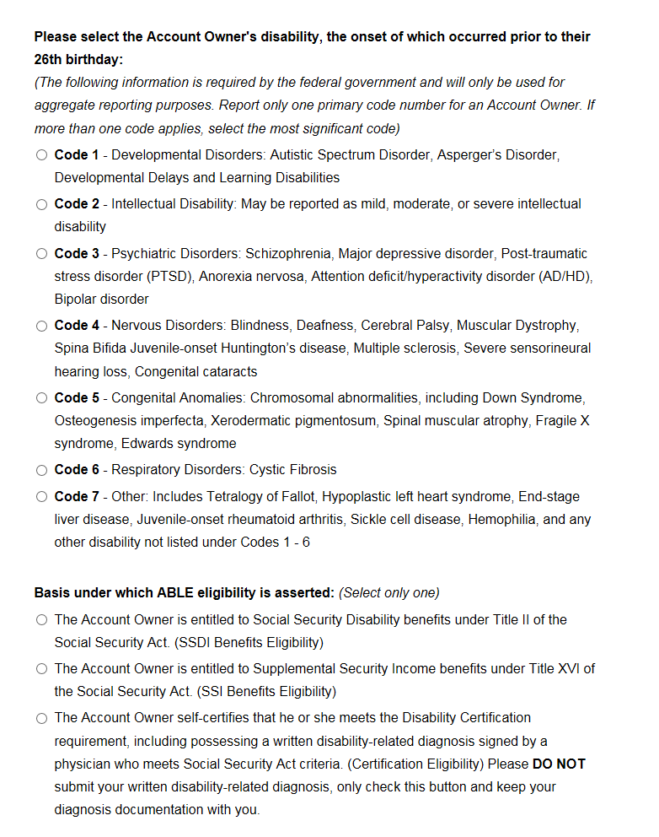
Online Enrollment
Step 1 (Cont’d)
46th birthday:
Select the Account Owners Disability Code – these codes are the same ones that the Social Security Uses. If you have more than one please select the most significant code .
Select the Eligibility Basis –
This would be either SSDI / SSI / Or a physician certification.
IMPORTANT: Please do not submit any documents related to your diagnosis.
Confidential: For Ascensus Internal purposes or Client use only
6

Slide 7
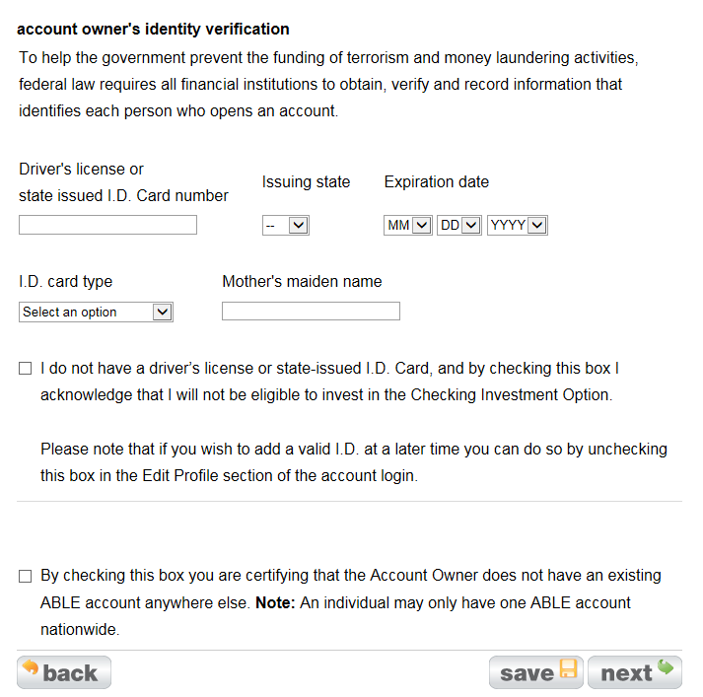
Online Enrollment
Step 1 (Cont’d)
Enter the Account Owner’s Identity Information – This information is needed if you are selecting the Checking Option as one of your investments.
If the Account Owner does not have a State-issued ID click the box indicating this
The last box on this page confirms that the Account Owner does not have an ABLE Account in anther plan, nationwide.
  If you are requesting that the funds be rolled over from another ABLE check this box off as the other ABLE plan will close when the funds are sent over to the plan
Confidential: For Ascensus Internal purposes or Client use only
7

Slide 8
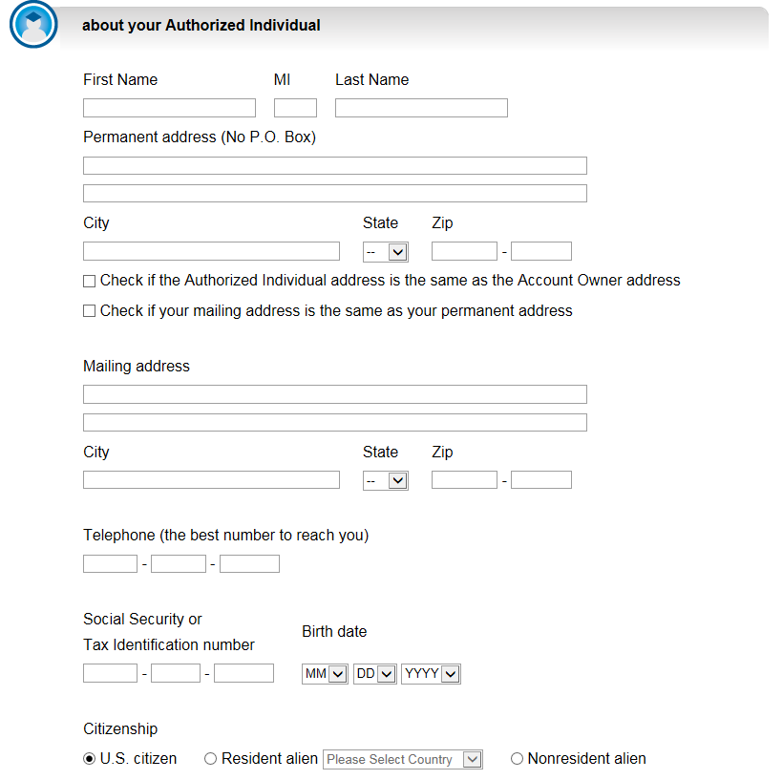
Online Enrollment
Step 2 – if applicable
Enter the Authorized Individual or Parent/Guardian information
  First Name
  Middle Initial
  Last Name
  Permanent Address
  Mailing Address
  Telephone Number
  Social Security Number
  Date of Birth
  Citizenship
Note: This section will not appear if you are opening an account that will be managed by the Account Owner
Confidential: For Ascensus Internal purposes or Client use only
8

Slide 9
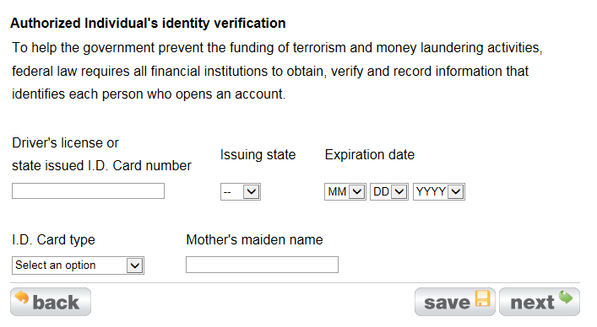
Online Enrollment
Step 2 – if applicable (Cont’d)
Enter the Authorized Individual or Parent/Guardians identity verification
Note: The information in this section is required even if you are not going to select the Checking Option.
Confidential: For Ascensus Internal purposes or Client use only
9

Slide 10
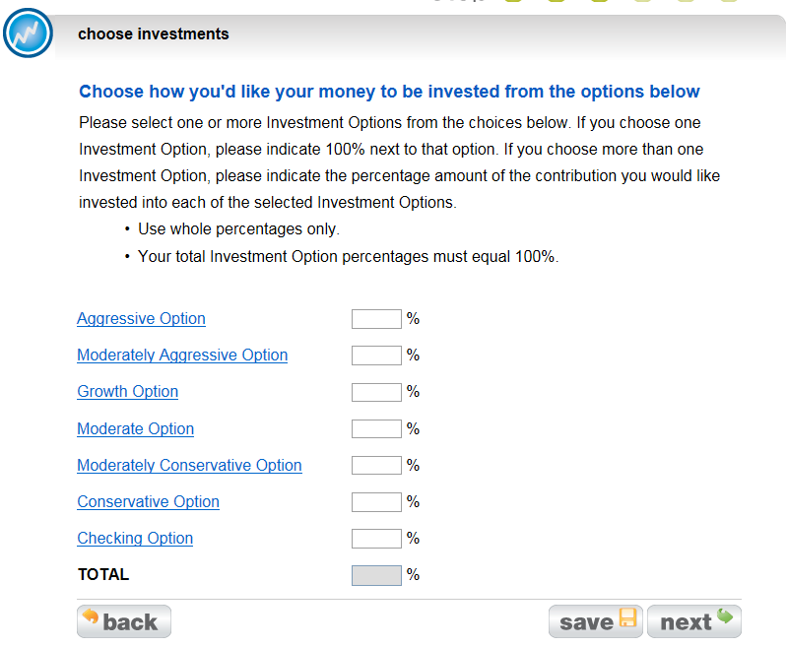
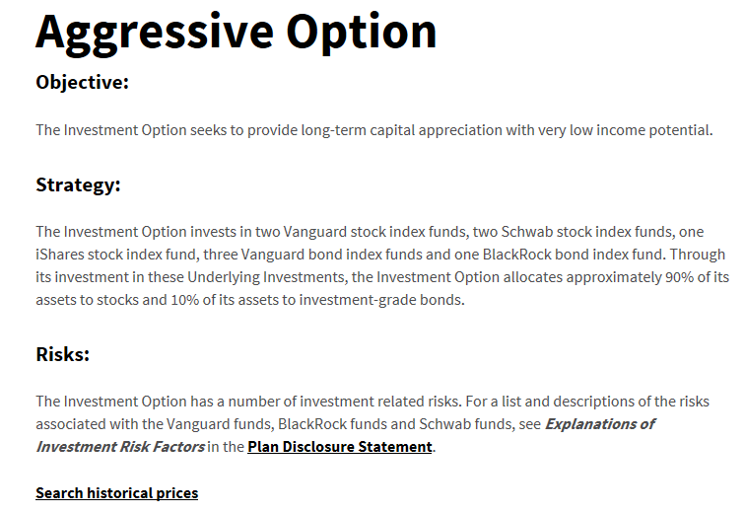
Online Enrollment
Step 3 –
Select the Investment Option
    If the AO or AI is unsure or would like addition information regarding the investment option, click on the name of the investment hyperlink, a new tab will open providing information on the investment selected.
Confidential: For Ascensus Internal purposes or Client use only
10

Slide 11
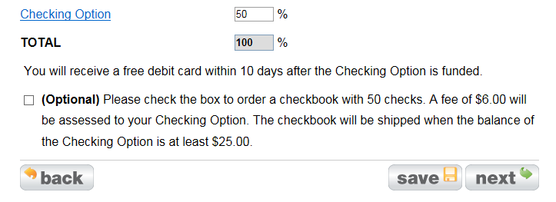
Online Enrollment
Step 3 (Cont’d)
If the checking option is selected, additional information will populate asking if you would like to order a checkbook with 50 checks.
Confidential: For Ascensus Internal purposes or Client use only
11

Slide 12
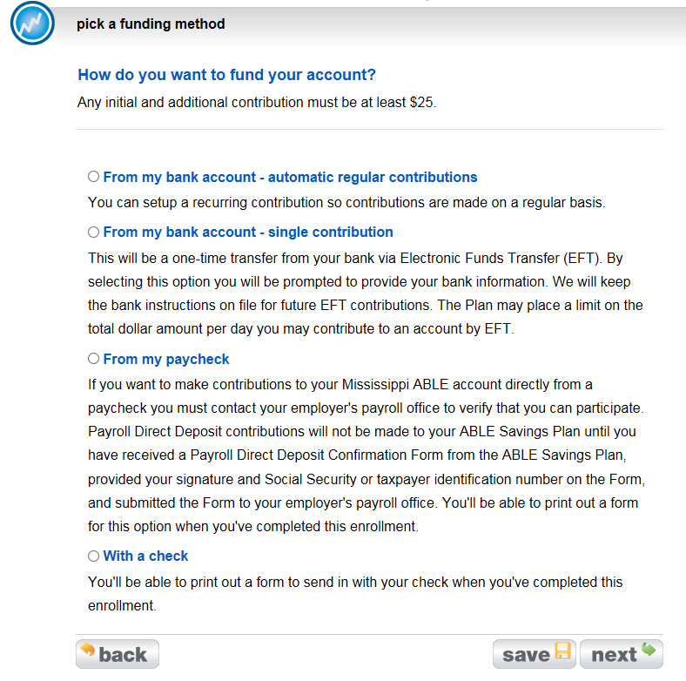
Online Enrollment flow
Funding Method
Select how you would like to fund the Account
    If you are opening an account as an Authorized Individual; only the last two options will be available. Because legal documents must be submitted for review it will only allow funding by Paycheck and Check.
Confidential: For Ascensus Internal purposes or Client use only
12

Slide 13
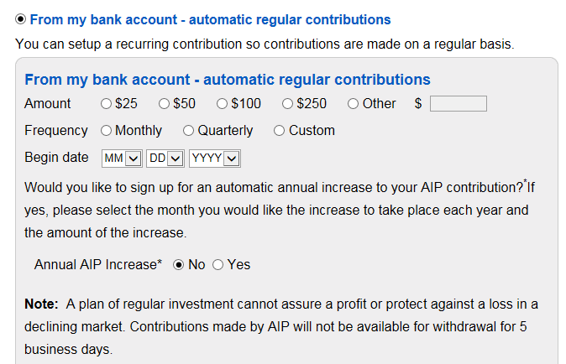
Online Enrollment flow
Funding Method (Cont’d)
For “From my bank account – automatic regular contributions” is selected.
  Select the dollar amount you would like to contribute
  Select the frequency
  Select the date to start
  You may also indicate if you would like to increase the dollar amount systematically ever year at a certain time.
Confidential: For Ascensus Internal purposes or Client use only
13

Slide 14
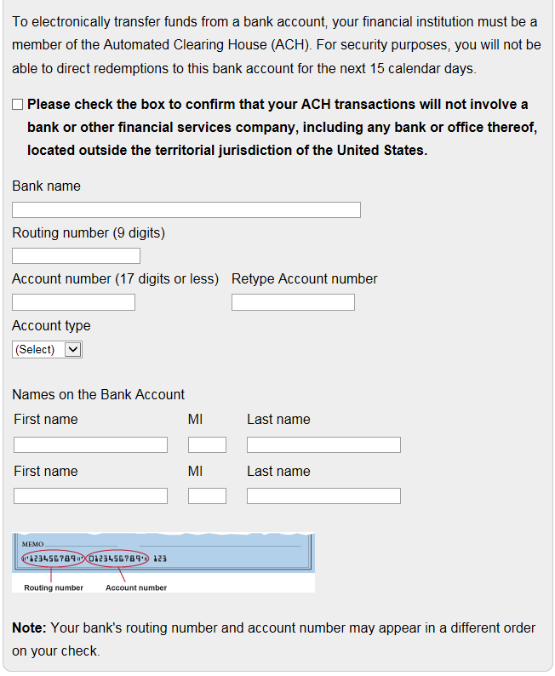
Online Enrollment flow
Funding Method (Cont’d)
For “From my bank account – automatic regular contributions” is selected.
  Check the box to confirm that your bank is within the United States
  Enter the Bank Name
  Enter the Routing Number (9 digits)
  Enter the Account number (17 digits or less)
  Re-enter the Account Number
  Indicate what type of Account it is
    Checking Account
    Savings Account
  Enter the name(s) that are listed on the Bank Account
Confidential: For Ascensus Internal purposes or Client use only
14

Slide 15
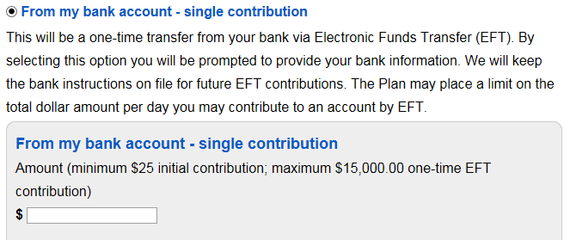
Online Enrollment flow
Funding Method (Cont’d)
If “From my bank account – single contribution” is selected
  Enter the Dollar amount you would like withdrawn from your account.
Confidential: For Ascensus Internal purposes or Client use only
15

Slide 16
Online Enrollment flow
Funding Method (Cont’d)
For “From my bank account – single contribution” is selected.
  Check the box to confirm that your bank is within the United States
  Enter the Bank Name
  Enter the Routing Number (9 digits)
  Enter the Account number (17 digits or less)
  Re-enter the Account Number
  Indicate what type of Account it is
    Checking Account
    Savings Account
  Enter the name(s) that are listed on the Bank Account
Confidential: For Ascensus Internal purposes or Client use only
16

Slide 17
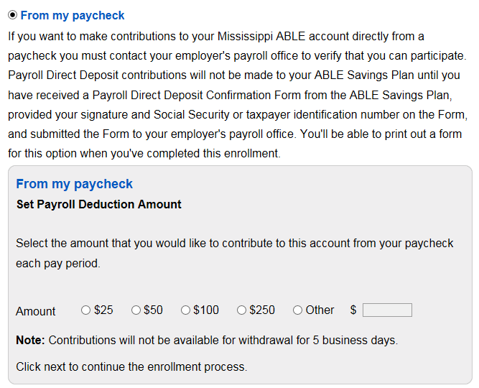
Online Enrollment flow
Funding Method (Cont’d)
If “From my paycheck” is selected
  Select/Enter the Dollar amount you would like to have withdrawn from you checking option.
Confidential: For Ascensus Internal purposes or Client use only
17

Slide 18
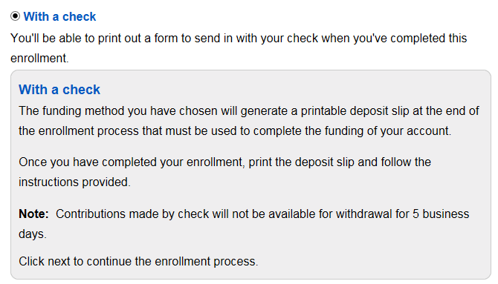
Online Enrollment flow
Funding Method (Cont’d)
If “With a Check” is selected
Confidential: For Ascensus Internal purposes or Client use only
18

Slide 19
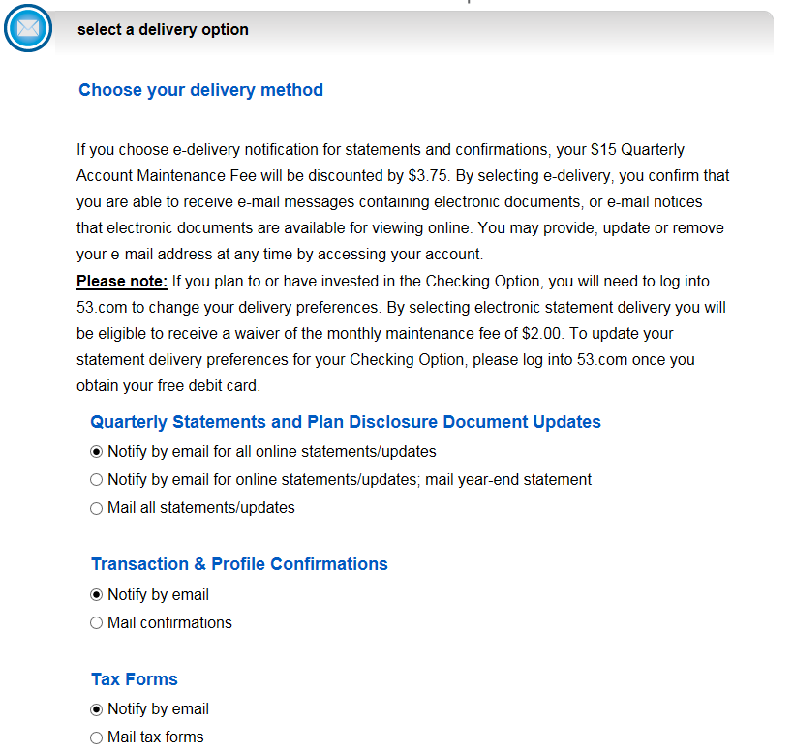
Online Enrollment flow
Delivery method
Select how you would like to have Statement, Confirmations, and Tax Forms. Either through the Mail or receive notification via email.
  If you select email you will be eligible to receive a discount of $3.75 from the Quarterly Account Maintenance Fee
Also, if you have selected the Checking Option as one of your investments you will be charged a monthly Maintenance Fee of $2.00. You will be able to waive this fee if you maintain an account balance of $250 or more or if you select to receive statement electronically as well.
Confidential: For Ascensus Internal purposes or Client use only
19

Slide 20
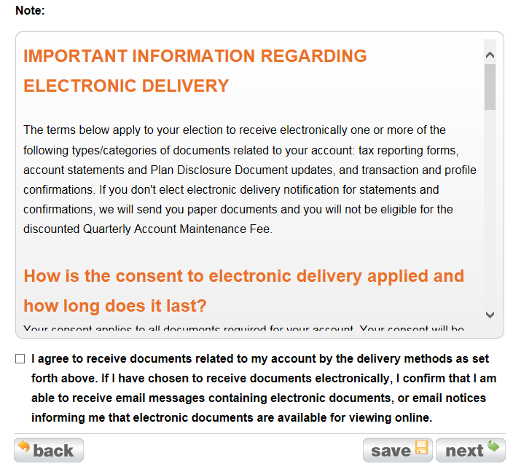
Online Enrollment flow
Delivery method (Cont’d)
Once the delivery option(s) are selected read through “Important Information regarding Electronic Delivery” and click the “I agree” box confirming they have read this information.
Confidential: For Ascensus Internal purposes or Client use only
20

Slide 21
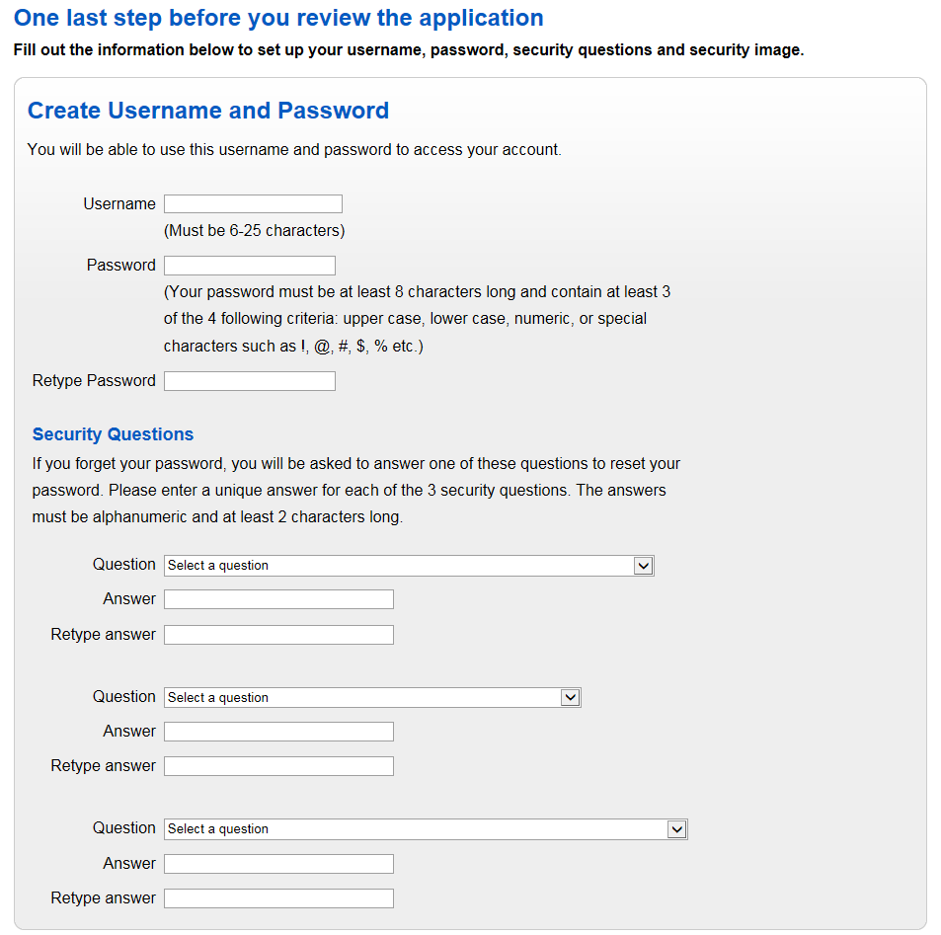
Online Enrollment flow
Create User Name & Password
Create a Username (This needs to be 6 – 25 characters in length)
Create a Password (This needs to be at least 8 characters in length; and adhere to at least 3 of the 4 different criteria
  Upper Case
  Lower Case
  Numeric
  Special Characters (i.e. !, @, #, $, %, etc)
Select and answer three separate Security Questions
Important: The answers to the Security Questions are case sensitive.
Confidential: For Ascensus Internal purposes or Client use only
21

Slide 22
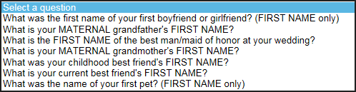
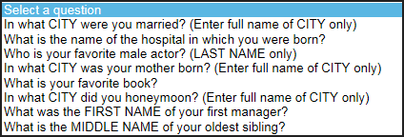
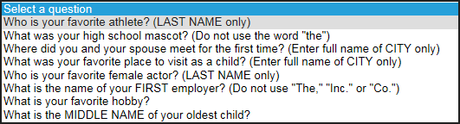
Online Enrollment flow
Create User Name & Password
Security Question 1
Security Question 2
Security Question 3
Confidential: For Ascensus Internal purposes or Client use only
22

Slide 23
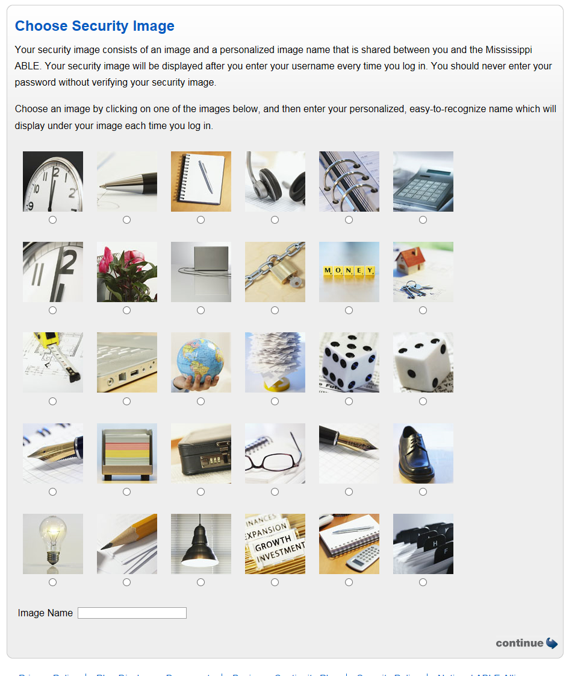
Online Enrollment flow
Choose Security Image
Select an image and enter an Image name
Confidential: For Ascensus Internal purposes or Client use only
23

Slide 24
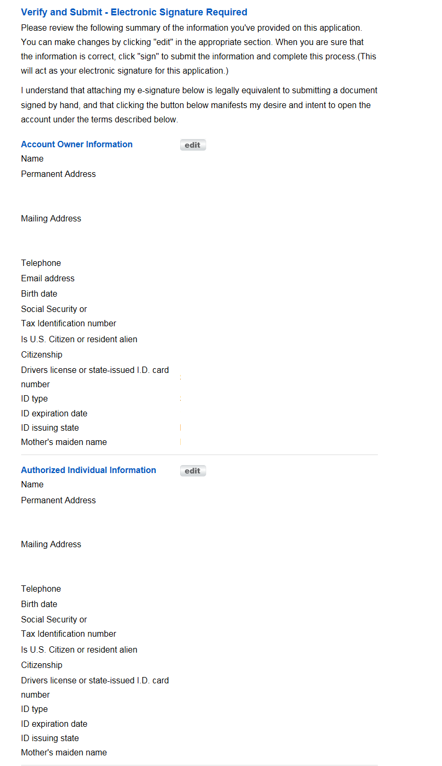
Online Enrollment flow
Verify & Submit
Reviews the information that has been entered to ensure its correct.
    If information is incorrect or needs click the “edit” button in the applicable section. This will bring them directly to the page for the applicable information that needs to be updated/corrected.
Confidential: For Ascensus Internal purposes or Client use only
24

Slide 25
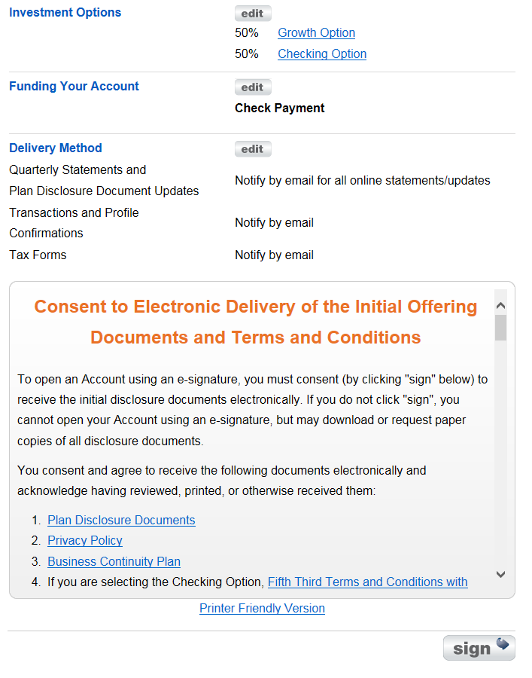
Online Enrollment flow
Verify & Submit (Cont’d)
Reviews the remaining information that has been input.
    If information is incorrect or needs click the “edit” button in the applicable section. This will bring them directly to the page for the applicable information that needs to be updated/corrected..
  Review the “Consent to Electronic….” section. If you have questions please reach out to MS ABLE at 800-609-3469 between 8am – 5pm CT.
  If there are no questions click on the “Sign” button.
Confidential: For Ascensus Internal purposes or Client use only
25

Slide 26
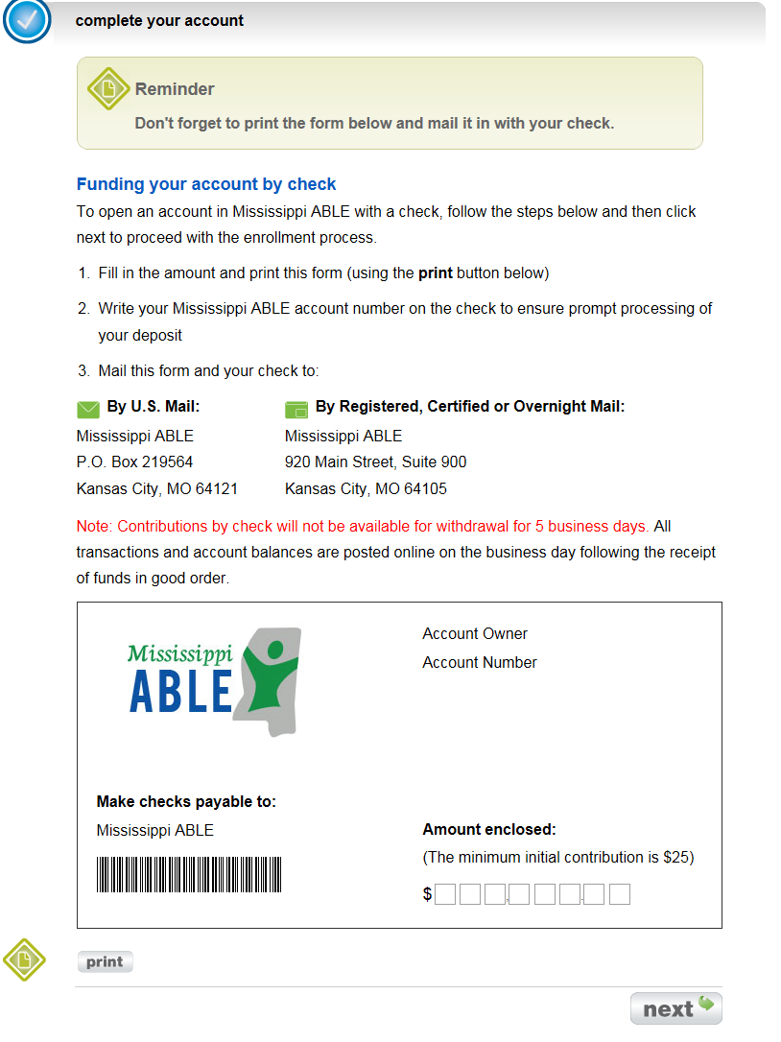
Online Enrollment flow
Funding your account
If you selected to fund your account via Check; print this coupon and send it along with your check.
Confidential: For Ascensus Internal purposes or Client use only
26

Slide 27
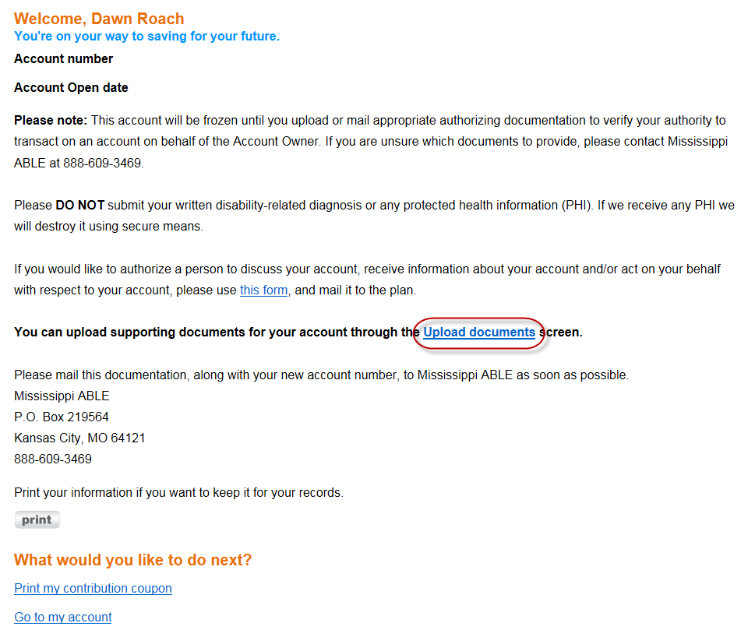
Online Enrollment flow
Confirmation
If legal documents need to be submitted click on the “Upload documents” link.
Confidential: For Ascensus Internal purposes or Client use only
27

Slide 28
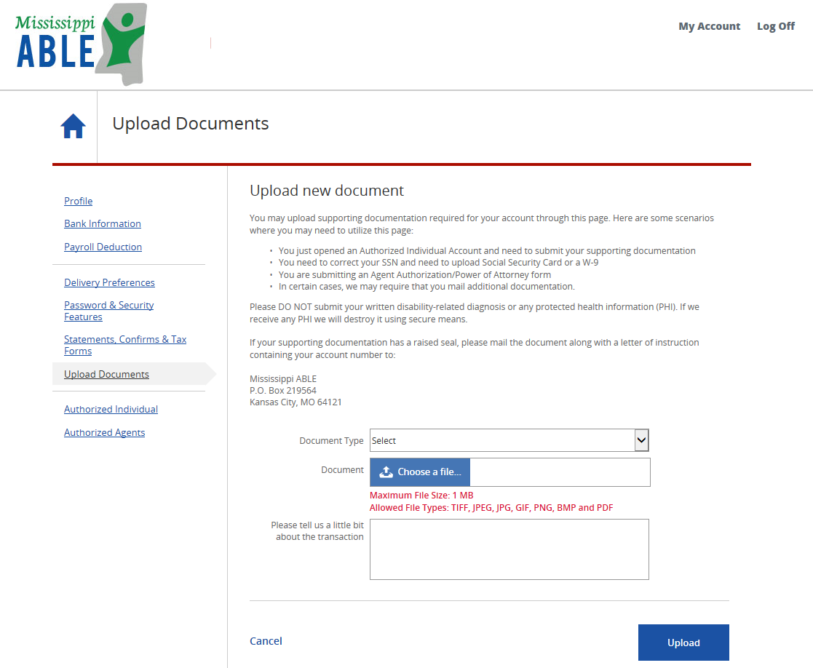
Online Enrollment flow
Upload Documents
Within the account you have the ability to Upload Documents. This allows for the applicable individual to submit their legal documents electronically.
Confidential: For Ascensus Internal purposes or Client use only
28

Slide 29
It only takes a few minutes.
  Visit ms.savewithable.com to learn more about the Program, request an information kit or enroll online.
  Call (888)-609-3469 to speak with a Program representative Monday through Friday, 8:00am – 5:00 pm ET.
We’re here to help.
Email us: ms.clientservice@savewithable.com
Contact us by mail:
Mississippi ABLE
P.O. Box 219564
Kansas City, MO 64121
Overnight Delivery:
Mississippi ABLE
920 Main Street
Suite 900
Kansas City, MO 64105

Slide 30
Important legal information.
  For more information about Mississippi ABLE (the “Member Plan”), call (888)-609-3469 or visit ms.savewithable.com to obtain Plan Disclosure Documents, which include investment objectives, risks, charges, expenses, and other important information; read and consider it carefully before investing.
  Investors should consider before investing whether their home state offers any state tax or other benefits that are only available for investments in such state’s qualified ABLE program. Investors should consult their legal, tax advisor and/or other advisor regarding their specific legal, investment or tax situation.
  The Member Plan is sponsored by the state of North Carolina and administered by the North Carolina Department of State Treasurer. The Member Plan is one of the qualified ABLE plans issued by the Ascensus ABLE Consortium Trust. Ascensus College Savings Recordkeeping Services, LLC, the Program Manager, and its affiliates have overall responsibility for the day-to-day operations, including investment advisory, recordkeeping and administrative services. The Member Plan offers a series of investment options within the Ascensus ABLE Consortium Trust. The Member Plan is intended to operate as a qualified ABLE plan to be used only to save for Qualified Disability Expenses, pursuant to the Section 529A of the U.S. Internal Revenue Code, as amended.
  This material is provided for general and educational purposes only, and is not intended to provide legal, tax or investment advice, or for use to avoid penalties that may be imposed under federal or state tax laws. This material is not an offer to sell or a solicitation of an offer to buy any securities.
  Participation in the Member Plan does not guarantee that contributions and the investment return on contributions, if any, will be adequate to cover future expenses or that an account owner is eligible to participate in the Member Plan.

